Slide 1
Story of Web Development
JF

Slide 2
Only about the things in my HEAD Only stories

Slide 3
Agenda
Born of HTTP and Web
HTTP, HTML, DOM, CSS, JS
CGI to enable interactive UI
PHP, ASP, JSP
WSGI and python based web frameworks
RoR and MVC in server side
Ajax
SPA

Slide 4
The Days Before Web
telnet
BBS
mud
ftp
Gopher
Emails
Newsgroup
IRC (maybe later)

Slide 5
Nothing New Under the Sun

Slide 6
Rome is not Built in a Day

Slide 7
Born of HTTP and WWW
TimBL - Tim Berners-Lee, 1990s, CERN
WWW: World Wide Web
Protocol, Sever, Client
HTTP versions
0.9 -> 1.0 -> 1.1
HTTP future?
http2.0
websocket
SPDY

Slide 8
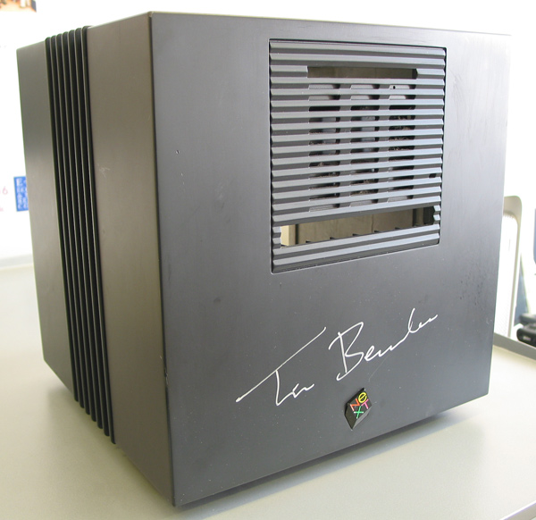

Slide 9
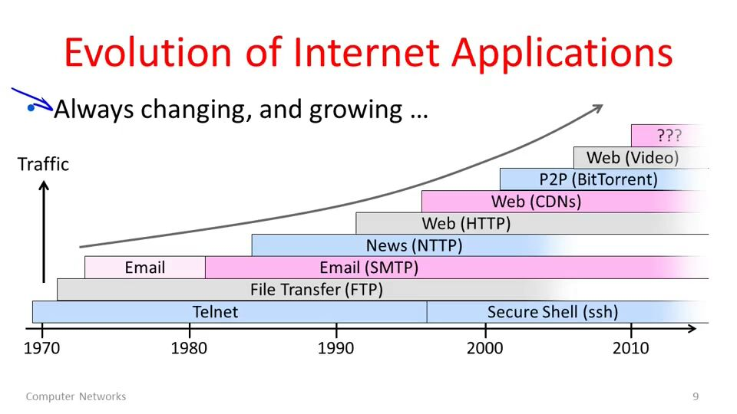

Slide 10
HTTP Servers
The 1st web server: CERN HTTPd
Apache
IIS
Nginx
Lighttpd
Micro servers for embedded

Slide 11
Web Browsers
The 1st Web client
Text based
“WorldWideWeb” -> Nexus
Mosaic -> Netscape Navigator -> Firefox
IE
Opera
Safari
Chrome
Text based browsers
Lync, links, w3m

Slide 12
HTTP – HyperText Transfer Protocol
All links - hyperlinks
Ping-pong – request and response
Methods
Status codes
Session
What’s “stateless”?
SSL and https

Slide 13
HTML – HyperText Markup Language
Markups
How many we are using?
Derived from SGML
Tags, open and close, not strict
XHTML and HTML4.01
HTML5
New stuff
DOM
Javescript

Slide 14
CSS – Cascading Style Sheets
Rules of “Progressive Enhancement”
Separation of content and style
Graceful degration
It can be used for generic purpose, not only Web
E.g. GUI applications

Slide 15
CGI – Common Gateway Interface
Static and Dynamic content for Web
Interactive between server side and client side
Standard of interface to transfer parameters
All parameters are go through environment vars
Any scripts and programming language can do CGI
Performance and alternatives
New process for each calling
FastCGI
Many apaches modules – mod_perl, mod_php, mod_python, etc

Slide 16
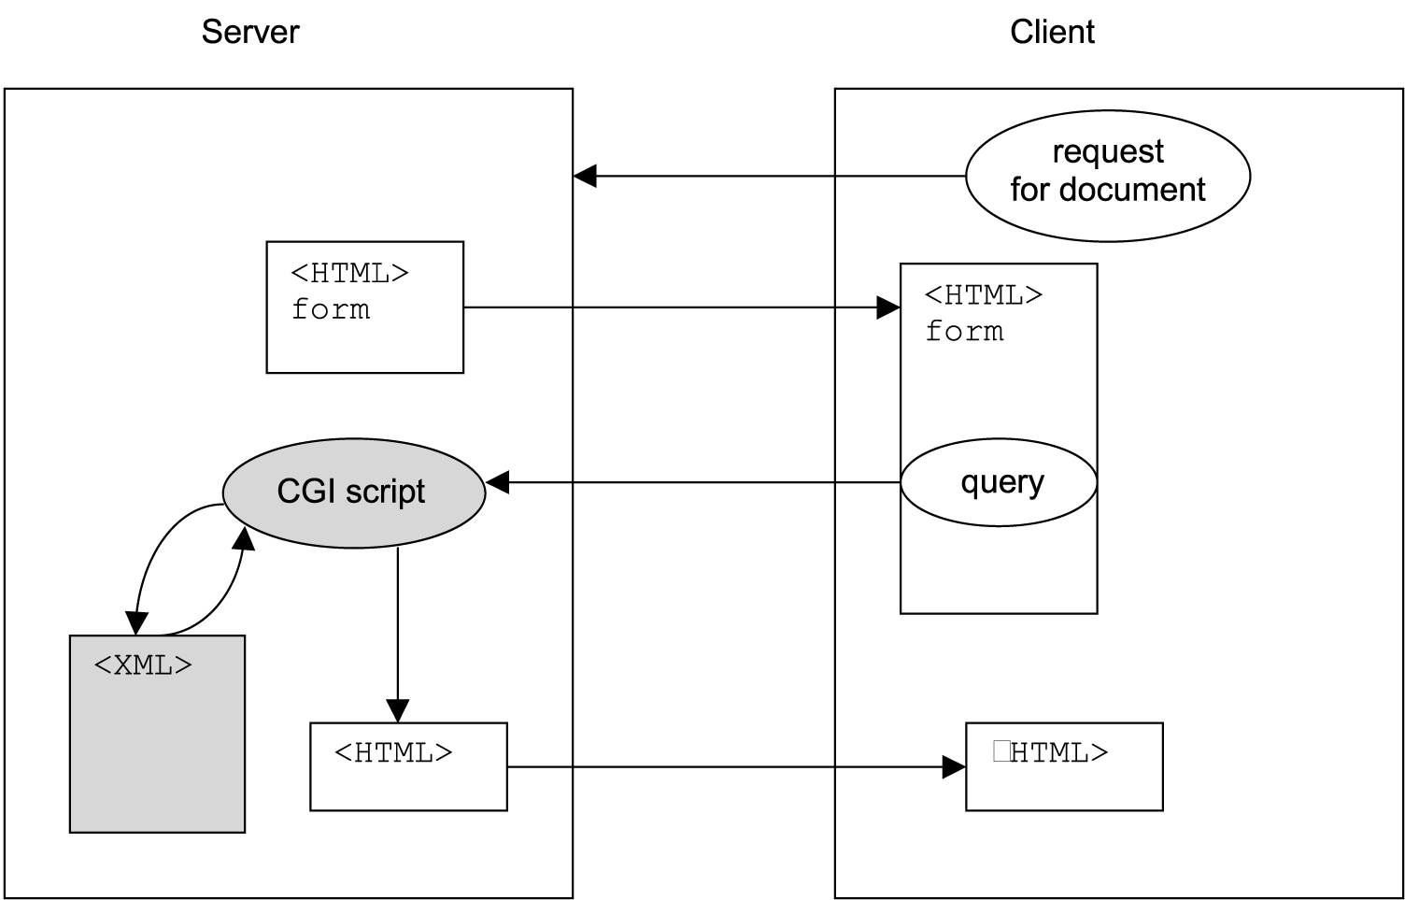

Slide 17
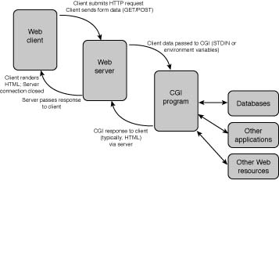

Slide 18
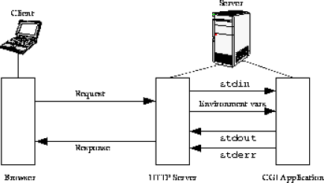

Slide 19
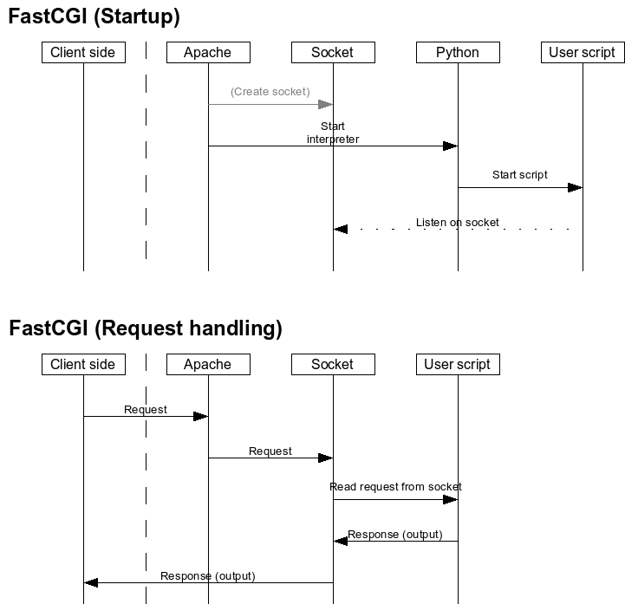
FastCGI

Slide 20
CGI – Sample of Apache Config
<Directory "/var/www/cgi-bin">
AllowOverride None
Options ExecCGI
Order allow,deny
Allow from all
</Directory>
<Directory "/var/www/cgi-bin">
Options All
</Directory>

Slide 21
CGI – sample.cgi (in Python)
#!/usr/bin/python
import os # Required header that tells the browser how to render the text. print "Content-Type: text/plain\n\n" # Print a simple message to the display window. print "Hello, World!\n“
# Print all env vars
for param in os.environ.keys():
print "%20s: %s" % (param, os.environ[param])

Slide 22
Output:
SERVER_SOFTWARE: Apache/2.2.22 (Ubuntu)
SCRIPT_NAME: /cgi-bin/penv.cgi
REQUEST_METHOD: GET
SERVER_PROTOCOL: HTTP/1.1
QUERY_STRING: abc=123
HTTP_USER_AGENT: Mozilla/5.0 (Windows NT 6.2; WOW64) AppleWebKit/537.36
SERVER_NAME: go.bj.intel.com
REMOTE_ADDR: 10.238.129.84
SERVER_PORT: 8080
SERVER_ADDR: 10.238.153.206
DOCUMENT_ROOT: /var/www
SCRIPT_FILENAME: /usr/lib/cgi-bin/penv.cgi
SERVER_ADMIN: webmaster@localhost
HTTP_HOST: go.bj.intel.com:8080
REQUEST_URI: /cgi-bin/penv.cgi?abc=123
GATEWAY_INTERFACE: CGI/1.1
REMOTE_PORT: 59731

Slide 23
PHP
“LAMP” -> “LEMP”
Embedded parts inside HTML -> Full-stack web development stack -> General-purpose programming scritps
Dynamic generated web pages
ASP, JSP
C style syntax, and many similar language designs with Perl, Java
Poor designed, but easy to ramp up and deployment

Slide 24
Hello World of PHP
<!DOCTYPE html>
<html>
<head>
<title>PHP Test</title>
</head>
<body>
<?php echo '<p>Hello World</p>'; ?>
</body>
</html>

Slide 25
RoR and MVC in Server Side
MVC
Model-View-Controller
Django – MTV
Full-stack web application development framework
RoR, Django is
Flask/bottle is not
Components
Web template system
ORM
Scafflolding
Request routing engine and URL mapping
Etc.

Slide 26
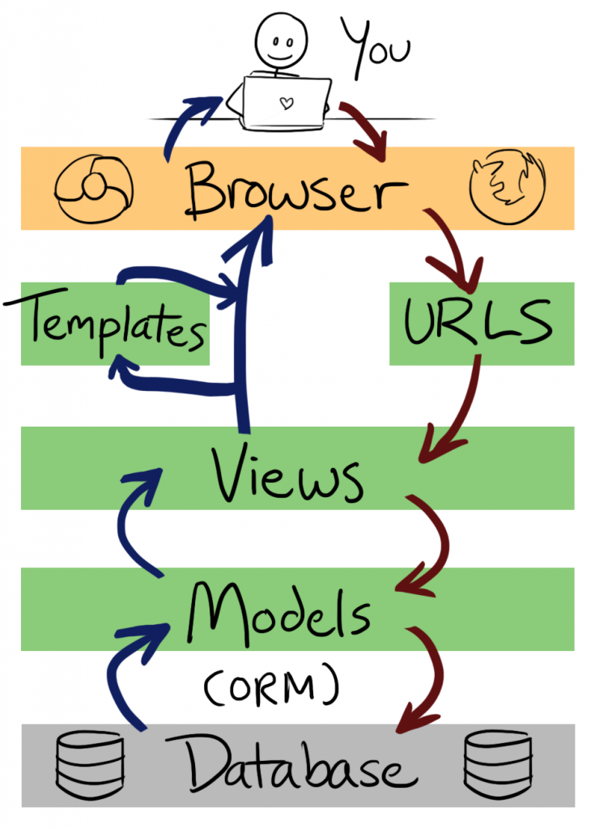

Slide 27
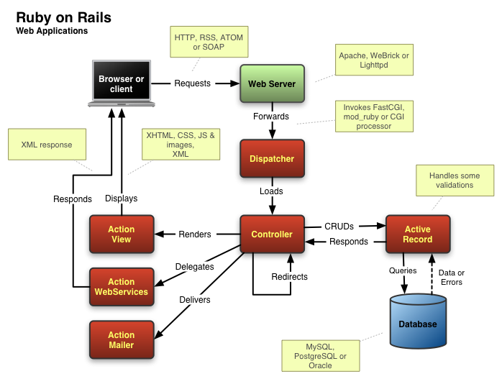

Slide 28


Ajax - Asynchronous JavaScript and XML

Slide 29
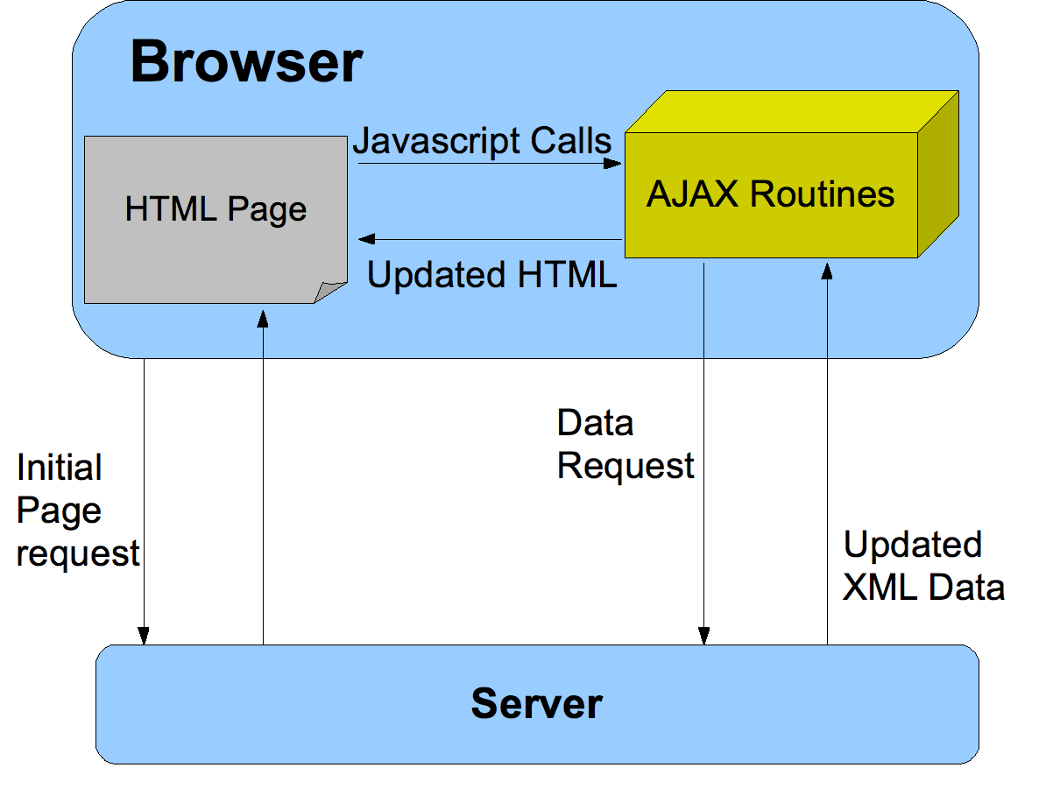

Slide 30
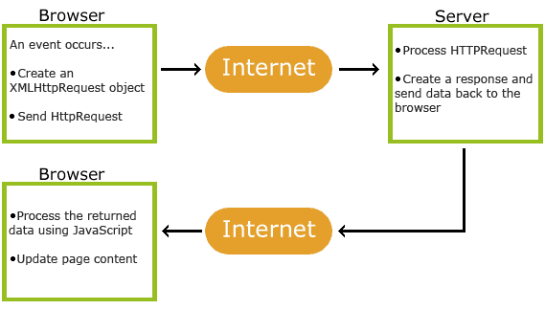

Slide 31
SPA – Single-page Application
CS - > BS -> CS plus
All static files will be loaded once – HTML, CSS, JS code
Browser side MVC
Ajax and RESTful APIs for data exchanging
XML, JSON
HTML5
Websocked, socked.io - for real-time communication
Local storage
Popular frameworks
Backbone.js, AngularJS

Slide 32
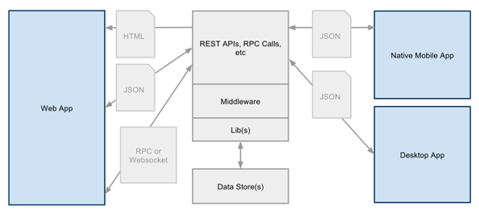

Slide 33
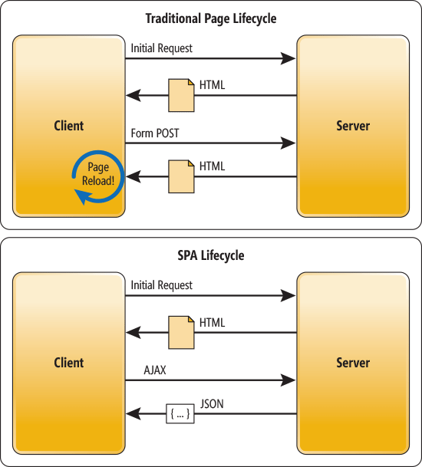

Slide 34
Q&A

